Slide 1
Machine Intuition
in Mobile Network Automation
Ph.D. defense of Márton Kajó
Technical University of Munich, Chair of Network Architectures and Services
April 5th, 2023
Chairman: Prof. Debarghya Ghoshdastidar, Ph. D.
Examiners: Prof. Dr.-Ing. Georg Carle
Prof. Dr. Rolf Stadler (KTH Royal Institute of Technology, Stockholm, Sweden)
Notes:
Thank you…
In the next 20 minutes, I would like to give a brief overview of my PhD work on Machine Intuition in Mobile Network Automation.

Slide 2
Machine Intuition
is Unsupervised Deep Learning
Mobile network automation targets tasks undertaken by humans.
The human-like logic of Deep Learning (DL) models fits these tasks.
Creating
Evaluating
Analyzing
Identify relationships
Labeled data is scarce in mobile networks.
Unsupervised learning is the preferred paradigm.
Applying
Use information in similar situations
Understanding
Remembering
Learning without the guidance of labels requires a higher cognitive capacity than supervised DL.
Bloom’s taxonomy of cognitive learning objectives
1
Notes:
In simple terms, what I mean by Machine Intuition is unsupervised deep learning, but there is a little more behind the name.
The goal of mobile network automation is to automate tasks that are currently undertaken by humans.
…

Slide 3
Machine Intuition
is Unsupervised Deep Learning
Mobile network automation targets tasks undertaken by humans.
The human-like logic of Deep Learning (DL) models fits these tasks.
Creating
Evaluating
Analyzing
Identify relationships
Labeled data is scarce in mobile networks.
Unsupervised learning is the preferred paradigm.
Applying
Use information in similar situations
Understanding
Remembering
Learning without the guidance of labels requires a higher cognitive capacity than supervised DL.
Bloom’s taxonomy of cognitive learning objectives
1
Notes:
Unfortunately, labeled data is scarce in mobile networks, so DL methods that can learn in an unsupervised way are preferred.

Slide 4
Machine Intuition
is Unsupervised Deep Learning
Mobile network automation targets tasks undertaken by humans.
The human-like logic of Deep Learning (DL) models fits these tasks.
Creating
Evaluating
Analyzing
Unsupervised DL
Identify relationships
Labeled data is scarce in mobile networks.
Unsupervised learning is the preferred paradigm.
Applying
Use information in similar situations
Supervised DL
Understanding
Remembering
Learning without the guidance of labels requires a higher cognitive capacity than supervised DL.
Bloom’s taxonomy of cognitive learning objectives
1
Notes:
I argue that learning without the guidance of labels is a harder task cognitively than supervised DL, so I would place unsupervised deep learning higher on the cognitive pyramid.

Slide 5
Machine Intuition
is Unsupervised Deep Learning
Mobile network automation targets tasks undertaken by humans.
The human-like logic of Deep Learning (DL) models fits these tasks.
Creating
Evaluating
Analyzing
Machine Intuition
Identify relationships
Labeled data is scarce in mobile networks.
Unsupervised learning is the preferred paradigm.
Applying
Use information in similar situations
Supervised DL
Understanding
Remembering
Learning without the guidance of labels requires a higher cognitive capacity than supervised DL.
Bloom’s taxonomy of cognitive learning objectives
Mobile network automation requires a sort of machine intuition.
1
Notes:
And this is why I say that mobile network automation requires a sort of machine intuition with an increased cognitive capability, to be able to remove human labor from the automation tasks.

Slide 6
Machine Intuition
in Mobile Network Automation
Research questions:
A) Can mobile network automation benefit from machine intuition (feasible/practical/applicable)?
B) Does machine intuition reduce/remove human labor?
2
Notes:
This reasoning raises two research questions, first:
…
Is it feasible, is it practical, and is it applicable to network automation use-cases?

Slide 7
Machine Intuition
in Mobile Network Automation
Research questions:
A) Can mobile network automation benefit from machine intuition (feasible/practical/applicable)?
B) Does machine intuition reduce/remove human labor?
2
Notes:
And second, does it actually fulfill the original promise of reducing or completely removing human labor?

Slide 8
Machine Intuition
in Mobile Network Automation
Unsupervised learning is not applicable to all problems. I have identified 4 areas where machine intuition is applicable in mobile network automation:
Exemplification (Part I)
Description of behavior through examples.
Tool: Quantization
Prediction (Part III)
Extrapolation of behavior into the future.
Tool: Sequence prediction
Associative Modeling (Part II)
Finding groups through mean-ingful similarity.
Tool: Clustering
Machine Confidence (Part IV)
Being critical of inputs and own inference.
Tool: Imputation
3
Notes:
Naturally, unsupervised DL is not applicable to just any problem.
During my work, I have identified 4 areas where machine intuition could be utilized:
…
These application areas also make up the 4 major parts of my dissertation.

Slide 9
Machine Intuition
in Mobile Network Automation
Unsupervised learning is not applicable to all problems. I have identified 4 areas where machine intuition is applicable in mobile network automation:
Exemplification (Part I)
Description of behavior through examples.
Tool: Quantization
Prediction (Part III)
Extrapolation of behavior into the future.
Tool: Sequence prediction
Associative Modeling (Part II)
Finding groups through mean-ingful similarity.
Tool: Clustering
Machine Confidence (Part IV)
Being critical of inputs and own inference.
Tool: Imputation
3
Notes:
In this presentation, out of these 4 areas, I would like to show my work in 2: associative modeling and machine confidence.

Slide 10
Machine Intuition
Presentation Agenda
1. Deep clustering of mobile network data:
1.1 Uses of clustering in mobile network automation
1.2. Deep clustering approaches
1.3. Own contribution: the DANCE algorithm
1.4. Evaluation results
Associative Modeling (Part II)
Finding groups through mean-ingful similarity.
Tool: Clustering
2. Communication and utilization of confidence values
2.1. Data corruption in cognitive function chains
2.2. Own contribution: the ICI algorithm
2.3. Evaluation results
Machine Confidence (Part IV)
Being critical of inputs and own inference.
Tool: Imputation
3. Conclusion and outlook on machine intuition
3.1. Recap of work and answer to research question A)
3.2. Outlook and answer to research question B)
4
Notes:
The rest of the presentation is organized as follows:
In the first part of the presentation, I will present our work on deep clustering of mobile network data, by introducing the topic, showing our own contribution (the DANCE algorithm) and some evaluation results.

Slide 11
Machine Intuition
Presentation Agenda
1. Deep clustering of mobile network data:
1.1 Uses of clustering in mobile network automation
1.2. Deep clustering approaches
1.3. Own contribution: the DANCE algorithm
1.4. Evaluation results
Associative Modeling (Part II)
Finding groups through mean-ingful similarity.
Tool: Clustering
2. Communication and utilization of confidence values
2.1. Data corruption in cognitive function chains
2.2. Own contribution: the ICI algorithm
2.3. Evaluation results
Machine Confidence (Part IV)
Being critical of inputs and own inference.
Tool: Imputation
3. Conclusion and outlook on machine intuition
3.1. Recap of work and answer to research question A)
3.2. Outlook and answer to research question B)
4
Notes:
In the second part, I will talk about the communication and utilization of confidence values, by once again introducing the topic, explaining our own contribution (the ICI algorithm) and presenting evaluation results.

Slide 12
Machine Intuition
Presentation Agenda
1. Deep clustering of mobile network data:
1.1 Uses of clustering in mobile network automation
1.2. Deep clustering approaches
1.3. Own contribution: the DANCE algorithm
1.4. Evaluation results
Associative Modeling (Part II)
Finding groups through mean-ingful similarity.
Tool: Clustering
2. Communication and utilization of confidence values
2.1. Data corruption in cognitive function chains
2.2. Own contribution: the ICI algorithm
2.3. Evaluation results
Machine Confidence (Part IV)
Being critical of inputs and own inference.
Tool: Imputation
3. Conclusion and outlook on machine intuition
3.1. Recap of work and answers to research questions
3.2. Outlook
4
Notes:
Finally, in the third part of the presentation I will give a recap of my whole work on machine intuition, answer the previously posed research questions, and finally give a brief outlook.

Slide 13
Part 1:
Deep Clustering of Mobile Network Data
Covered in Chapter 7 of the dissertation
Based on the publication:
Clustering Mobile Network Data with Decorrelating Adversarial Nets
M. Kajó, J. Schnellbach, S. S. Mwanje and G. Carle
NOMS 2022-2022 IEEE/IFIP Network Operations and Management Symposium, 2022, pp. 1-9
Notes:
Without further ado, let’s jump into the first part: …
This topic is covered in chapter 7 of my dissertation, and it is based on our paper: Clustering Mobile Network Data with decorrelating Adversarial Nets

Slide 14
Deep Clustering of Mobile Network Data
1.1 Uses of Clustering in Mobile Network Automation
Clustering is the act of finding groups in the data.
Clustering can be used as:
an unsupervised alternative to classification in DL-based network automation functions, or as
Label some data
a data labeling tool: clusters can be formed using a larger unlabeled dataset, and then labeled according to a small set of labelled examples.
Unlabeled data
Labeled data
Clustering
5

Slide 15
Deep Clustering of Mobile Network Data
1.1 Uses of Clustering in Mobile Network Automation
Clustering is the act of finding groups in the data.
Clustering can be used as:
an unsupervised alternative to classification in DL-based network automation functions, or as
Label some data
a data labeling tool: clusters can be formed using a larger unlabeled dataset, and then labeled according to a small set of labelled examples.
Unlabeled data
Labeled data
Clustering
5

Slide 16
Deep Clustering of Mobile Network Data
1.1 Uses of Clustering in Mobile Network Automation
Clustering is the act of finding groups in the data.
Clustering can be used as:
an unsupervised alternative to classification in DL-based network automation functions, or as
Label some data
a data labeling tool: clusters can be formed using a larger unlabeled dataset, and then labeled according to a small set of labelled examples.
Unlabeled data
Labeled data
Clustering
5

Slide 17
Deep Clustering of Mobile Network Data
1.1 Uses of Clustering in Mobile Network Automation
Clustering is the act of finding groups in the data.
Clustering can be used as:
an unsupervised alternative to classification in DL-based network automation functions, or as
Label some data
a data labeling tool: clusters can be formed using a larger unlabeled dataset, and then labeled according to a small set of labelled examples.
Unlabeled data
Labeled data
Clustering
Research goal: designing a high-performance deep clustering method for mobile network data.
5
Notes:
So, our research goal was to design a high-performance …

Slide 18
Deep Clustering of Mobile Network Data
1.2 Deep Clustering Approaches
k-Means
Clusters
Reconstructive deep clustering:
Clusters defined from the encoded representation of Autoencoders (AEs).
Domain-agnostic regularization.
Regularization
Encoder
Decoder
Data
Encoded repres.
Rec. data
Discriminative deep clustering:
Clusters defined directly from the original representation.
Domain-specific regularization.
Encoder
Data
Clusters
Regularization
Constraints
6
Notes:
Deep clustering can be approached in two major ways: reconstructive clustering, where the deep learning model learns to encode the original data into a simpler, encoded representation, in which it is easy to find clusters with some machine learning algorithm, such as k-means.
However, parallel to learning this encoding, the deep learning model also learns to reconstruct the original observations from the encoded space, with this reconstruction acting as a regularization for the whole model.

Slide 19
Deep Clustering of Mobile Network Data
1.2 Deep Clustering Approaches
k-Means
Clusters
Reconstructive deep clustering:
Clusters defined from the encoded representation of Autoencoders (AEs).
Domain-agnostic regularization.
Regularization
Encoder
Decoder
Data
Encoded repres.
Rec. data
Discriminative deep clustering:
Clusters defined directly from the original representation.
Domain-specific regularization.
Encoder
Data
Clusters
Regularization
Constraints
6
Notes:
The other approach is discriminative clustering, where the clusters are immediately formed in in the original data-space, and the regularization is done through hand-defined constraints, which are specific for the use-case.

Slide 20
Deep Clustering of Mobile Network Data
1.2 Deep Clustering Approaches
k-Means
Clusters
Reconstructive deep clustering:
Clusters defined from the encoded representation of Autoencoders (AEs).
Domain-agnostic regularization.
Regularization
Encoder
Decoder
Data
Encoded repres.
Rec. data
Discriminative deep clustering:
Clusters defined directly from the original representation.
Domain-specific regularization.
Encoder
Data
Clusters
Regularization
Constraints
6
Notes:
We have chosen reconstructive deep clustering, because its regularization is easy to apply to mobile network data.

Slide 21
Deep Clustering of Mobile Network Data
1.2 Deep Clustering Approaches
k-Means
Clusters
Reconstructive deep clustering:
Clusters defined from the encoded representation of Autoencoders (AEs).
Domain-agnostic regularization.
Regularization
Encoder
Decoder
Data
Encoded repres.
Rec. data
Discriminative deep clustering:
Clusters defined directly from the original representation.
Domain-specific regularization.
Encoder
Data
Clusters
Regularization
Constraints
Reconstructive clustering often suffers from irrelevant information in the encoded representation.
6
Notes:
Unfortunately, a common problem with reconstructive deep clustering is that the encoded space often contains a lot of irrelevant information that is unnecessary for clustering, which makes the clusters harder to distinguish.

Slide 22
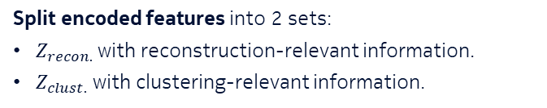
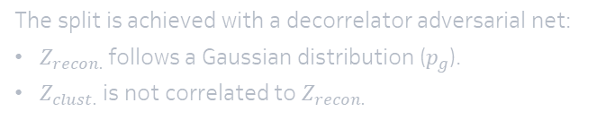



Deep Clustering of Mobile Network Data
1.3 Own contribution: the DANCE algorithm
Split encoded features into 2 sets:
$Z_{recon.}$ with reconstruction-relevant information.
$Z_{clust.}$ with clustering-relevant information.
The split is achieved with a decorrelator adversarial net:
$Z_{recon.}$ follows a Gaussian distribution ($p_{g}$).
$Z_{clust.}$ is not correlated to $Z_{recon.}$
$$p_{g}$$
Decorr.
Encoder
$$Z_{recon.}$$
Decoder
Data
Rec. data
$$Z_{clust.}$$
k-Means
Clusters
Clustering relevant information only
7
Notes:
To solve this, our idea is to split the encoded features into 2 sets:
One that contains only reconstruction-relevant information, and one that contains the clustering-relevant information, and look for clusters only in the clustering relevant feature-set.

Slide 23
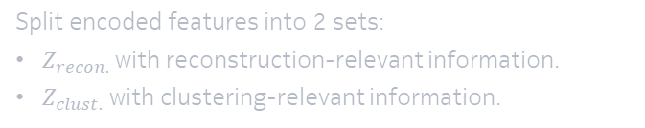
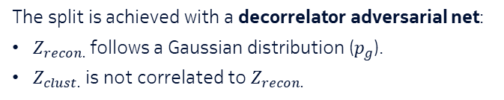

Deep Clustering of Mobile Network Data
1.3 Own contribution: the DANCE algorithm
Split encoded features into 2 sets:
$Z_{recon.}$ with reconstruction-relevant information.
$Z_{clust.}$ with clustering-relevant information.
The split is achieved with a decorrelator adversarial net:
$Z_{recon.}$ follows a Gaussian distribution ($p_{g}$).
$Z_{clust.}$ is not correlated to $Z_{recon.}$
$$p_{g}$$
Decorr.
Encoder
$$Z_{recon.}$$
Decoder
Data
Rec. data
$$Z_{clust.}$$
k-Means
Clusters
Clustering relevant information only
7
Notes:
The splitting is achieved by a decorrelator adversarial net, similar to generative adversarial nets, which forces the reconstructive features to follow a Gaussian distribution, while also making sure that the clustering relevant features are not correlated to the reconstructive features.

Slide 24
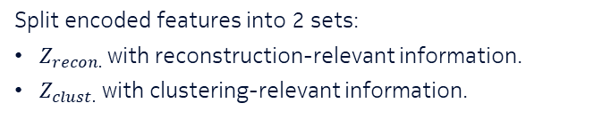
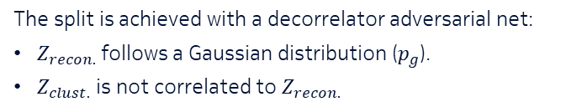
Deep Clustering of Mobile Network Data
1.3 Own contribution: the DANCE algorithm
Split encoded features into 2 sets:
$Z_{recon.}$ with reconstruction-relevant information.
$Z_{clust.}$ with clustering-relevant information.
The split is achieved with a decorrelator adversarial net:
$Z_{recon.}$ follows a Gaussian distribution ($p_{g}$).
$Z_{clust.}$ is not correlated to $Z_{recon.}$
$$p_{g}$$
Decorr.
Encoder
$$Z_{recon.}$$
Decoder
Data
Rec. data
$$Z_{clust.}$$
k-Means
Clusters
Our contribution: Decorrelating Adversarial Nets for Clustering-friendly Encodings (DANCE)
7
Notes:
And this is our contribution to deep clustering, which we call …, which abbreviates to DANCE.

Slide 25
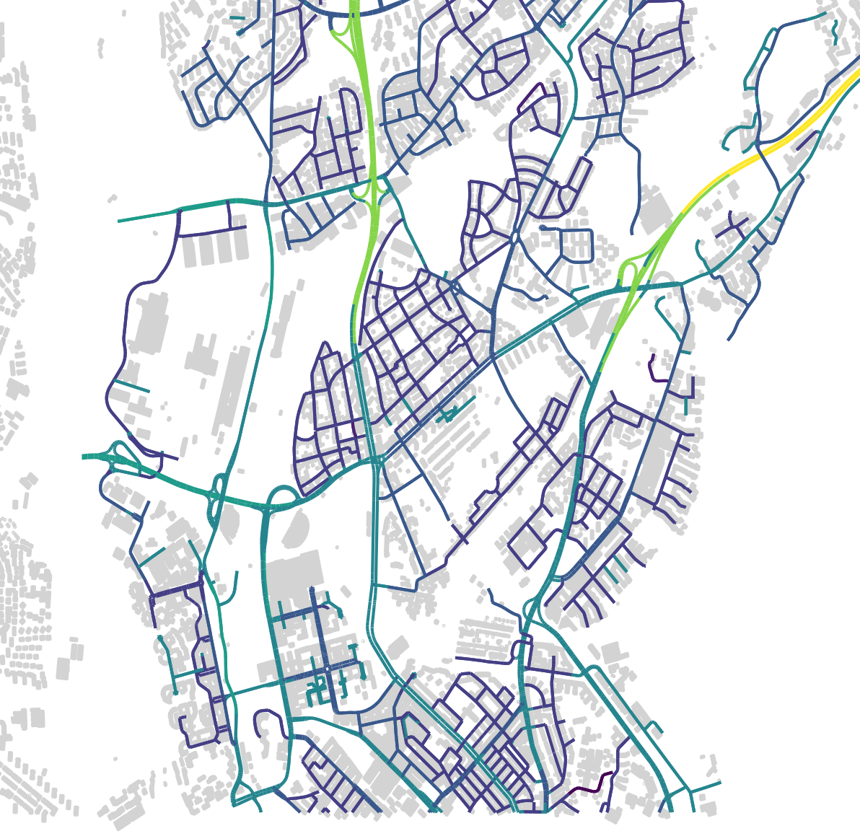

Deep Clustering of Mobile Network Data
1.4 Evaluation Results
Collected simulated mobile network data containing 8 user groups:
 | Traffic | Speed [km/h] | Occupied area
Stationary FTP | FTP | 0 | Inner & outer
Stationary VoIP | VoIP | 0 | Inner & outer
Stationary HTTP | HTTP | 0 | Inner & outer
Pedestrian FTP | FTP | 4-10 | Inner circle
Pedestrian VoIP | VoIP | 4-10 | Inner circle
Pedestrian HTTP | HTTP | 4-10 | Inner circle
Vehicular FTP | FTP | 10-100 | Outer ring
Vehicular VoIP | VoIP | 10-100 | Outer ring
With the ground-truth labels known from the simulation, we can measure clustering accuracy (ACC):
Omni micro
$$ACC= \frac{n_{corretcly_labeled}}{n_{all_observations}}$$
3-sector macro
8
Notes:
To evaluate our algorithm, we used a dataset from a mobile network simulator, in which 8 user groups were utilizing a simulated mobile network.
The user groups were distinguished by their network traffic: FTP, VoIP and HTTP, and by their movement speed and occupied area.
The job of the clustering algorithm was to figure out which group the user belongs to by processing a trace of the user’s data.

Slide 26
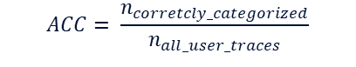
Deep Clustering of Mobile Network Data
1.4 Evaluation Results
Collected simulated mobile network data containing 8 user groups:
 | Traffic | Speed [km/h] | Occupied area
Stationary FTP | FTP | 0 | Inner & outer
Stationary VoIP | VoIP | 0 | Inner & outer
Stationary HTTP | HTTP | 0 | Inner & outer
Pedestrian FTP | FTP | 4-10 | Inner circle
Pedestrian VoIP | VoIP | 4-10 | Inner circle
Pedestrian HTTP | HTTP | 4-10 | Inner circle
Vehicular FTP | FTP | 10-100 | Outer ring
Vehicular VoIP | VoIP | 10-100 | Outer ring
With the ground-truth labels known from the simulation, we can measure clustering accuracy (ACC):
Omni micro
$$ACC= \frac{n_{corretcly_categorized}}{n_{all_user_traces}}$$
3-sector macro
8
Notes:
Because we knew the ground truth from the simulation, we were able to measure the clustering accuracy of the models, which is the ratio of the number of correctly categorized user traces divided by the number of all user traces.
1.0 is perfect accuracy, 0.0 is a miscategorization of all observations.

Slide 27
Deep Clustering of Mobile Network Data
1.4 Evaluation Results
 |  | Publication | Recon. | Discr. | Feat. split | ACC
DEC | Deep Embedded Clustering | [Xie et al., 2016] | ✔ |  |  | 0.7409
ACAI | Adversarially Constrained Autoencoder Interpolation | [Berthelot et al., 2016] | ✔ |  |  | 0.7629
IMSAT | Information Maximizing Self-Augmented Training | [Hu et al., 2017] |  | ✔ |  | 0.4775
DCCS | Deep image Clustering with Category-Style representation | [Zhao et al., 2020] |  | ✔ | ✔ | 0.8416
9
Notes:
We have chosen 4 state-of-the-art deep clustering methods to compete with DANCE in our evaluation, 2 reconstructive: DEC and ACAI, and 2 discriminative methods: IMSAT and DCCS, out of which DCCS also somewhat shares the same feature splitting idea with DANCE.

Slide 28
Deep Clustering of Mobile Network Data
1.4 Evaluation Results
 |  | Publication | Recon. | Discr. | Feat. split | ACC
DEC | Deep Embedded Clustering | [Xie et al., 2016] | ✔ |  |  | 0.7409
ACAI | Adversarially Constrained Autoencoder Interpolation | [Berthelot et al., 2016] | ✔ |  |  | 0.7629
IMSAT | Information Maximizing Self-Augmented Training | [Hu et al., 2017] |  | ✔ |  | 0.4775
DCCS | Deep image Clustering with Category-Style representation | [Zhao et al., 2020] |  | ✔ | ✔ | 0.8416
DANCE | Decorrelating Adversarial Nets with Clustering-friendly Encodings | [Kajo et al., 2022] | ✔ |  | ✔ | 0.8923
9
Notes:
However, our DANCE algorithm outperformed all of the algorithms by a large margin.

Slide 29
Deep Clustering of Mobile Network Data
1.4 Evaluation Results
 |  | Publication | Recon. | Discr. | Feat. split | ACC
DEC | Deep Embedded Clustering | [Xie et al., 2016] | ✔ |  |  | 0.7409
ACAI | Adversarially Constrained Autoencoder Interpolation | [Berthelot et al., 2016] | ✔ |  |  | 0.7629
IMSAT | Information Maximizing Self-Augmented Training | [Hu et al., 2017] |  | ✔ |  | 0.4775
DCCS | Deep image Clustering with Category-Style representation | [Zhao et al., 2020] |  | ✔ | ✔ | 0.8416
DANCE | Decorrelating Adversarial Nets with Clustering-friendly Encodings | [Kajo et al., 2022] | ✔ |  | ✔ | 0.8923
Using reconstructive clustering with feature splitting, DANCE is a high-performance clustering on network data.
9
Notes:
So we can say that we achieved our goal of creating a high-performance deep clustering algorithm that works on mobile network data.

Slide 30
Part 2:
Communication and Utilization of Confidence Values
Covered in Chapter 12 of the dissertation
Based on the publication:
Robust Deep Learning against Corrupted Data in Cognitive Autonomous Networks
M. Kajó, J. Schnellbach, S. S. Mwanje and G. Carle
NOMS 2022-2022 IEEE/IFIP Network Operations and Management Symposium, 2022, pp. 1-7
Notes:
Moving on to part 2, I would like to now talk about our work on …
This topic is covered by chapter 12 in my dissertation, and it is based on our publication titled: Robust deep learning against corrupted data in cognitive autonomous networks

Slide 31

Communication and Utilization of Confidence Values
2.1 Data Corruption in Cognitive Function Chains
DL-based Cognitive Function (CF) chains propagate and possibly multiply corrupted values, likely leading to severe impact.
If the corrupted values are signaled through a “mask” attached to communicated data, the task is called imputation.
Network
Corrupted value
Multiple corrupted values
CF₁
CF₂
Erroneous decision
Data
Proc. data
10
Notes:
In mobile networks, it is a frequent occurrence that measurements have errors or are partially missing, which we call here as corrupted data.
If there are DL-based network automation functions – which in this case we call Cognitive Functions or CFs – in a chain, then passing corrupted information between them can further worsen the effect by amplifying or multiplying the corrupted values.
…

Slide 32

Communication and Utilization of Confidence Values
2.1 Data Corruption in Cognitive Function Chains
DL-based Cognitive Function (CF) chains propagate and possibly multiply corrupted values, likely leading to severe impact.
If the corrupted values are signaled through a “mask” attached to communicated data, the task is called imputation.
Network
Corrupted value
Fewer corrupted values
CF₁
CF₂
Correct decision
Data + mask
Proc. data + mask
10
Notes:
Since most of these data corruptions are not from a malicious nature, they are easy to recognize, so we can attach a mask to the data which highlights which observations are corrupted, which the CFs could utilize to avoid the propagation of corrupted information.
This problem is the well-known machine learning problem of imputation: the reconstruction of missing values in a dataset.

Slide 33
Communication and Utilization of Confidence Values
2.1 Data Corruption in Cognitive Function Chains
DL-based Cognitive Function (CF) chains propagate and possibly multiply corrupted values, likely leading to severe impact.
If the corrupted values are signaled through a “mask” attached to communicated data, the task is called imputation.
Network
Corrupted value
Fewer corrupted values
CF₁
CF₂
Correct decision
Data + mask
Proc. data + mask
Research goal: designing a high-performance deep imputation for cognitive functions.
10
Notes:
Our goal here was to create a high-performance deep imputation method that works well for CFs or even CF chains.

Slide 34

Communication and Utilization of Confidence Values
2.1 Own Contribution: the ICI Algorithm
As both the imputer and the classifier models the same data, it is likely they will be of roughly the same complexity.
The imputation capability could be integrated into the DL-based CF.
Control decision
Data+mask
Imputer
Imp. data
Classifier
Control decision
Data+mask
ICI
11
Notes:
Our contribution to this topic follows the idea that, since the CF (in this case a classifier) models the data, and the imputation model models the same data, they roughly have the same complexity, so we could merge the two models into a single one

Slide 35
Communication and Utilization of Confidence Values
2.1 Own Contribution: the ICI Algorithm
As both the imputer and the classifier models the same data, it is likely they will be of roughly the same complexity.
The imputation capability could be integrated into the DL-based CF.
Control decision
Data+mask
Imputer
Imp. data
Classifier
Control decision
Data+mask
ICI
11

Slide 36
Communication and Utilization of Confidence Values
2.1 Own Contribution: the ICI Algorithm
As both the imputer and the classifier models the same data, it is likely they will be of roughly the same complexity.
The imputation capability could be integrated into the DL-based CF.
Control decision
Data+mask
Imputer
Imp. data
Classifier
Control decision
Data+mask
ICI
Our contribution: Integrated Classification with Imputation (ICI)
11
Notes:
And this is our contribution, which we call integrated classification with imputation, or ICI for short.

Slide 37
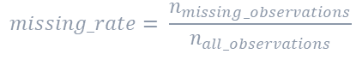

Communication and Utilization of Confidence Values
2.3 Evaluation Results
The evaluation dataset is the same as shown before, with 8 user groups present in the simulation.
Values are randomly corrupted in the dataset, according to a missing rate:
Classification accuracy (ACC) is measured after a hypothetical CF utilizes the imputed dataset:
$$missing_rate= \frac{n_{missing_observations}}{n_{all_observations}}$$
$$ACC= \frac{n_{corretcly_categorized}}{n_{all_user_traces}}$$
Inferred label
Data+mask
Imputer
Imp. data
Classifier
Inferred label
Data+mask
ICI
12
Notes:
The evaluation used the same dataset that I have introduced before, with 8 user groups.

Slide 38
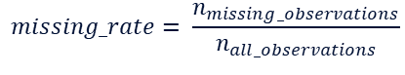
Communication and Utilization of Confidence Values
2.3 Evaluation Results
The evaluation dataset is the same as shown before, with 8 user groups present in the simulation.
Values are randomly corrupted in the dataset, according to a missing rate:
Classification accuracy (ACC) is measured after a hypothetical CF utilizes the imputed dataset:
$$missing_rate= \frac{n_{missing_observations}}{n_{all_observations}}$$
$$ACC= \frac{n_{corretcly_categorized}}{n_{all_user_traces}}$$
Inferred label
Data+mask
Imputer
Imp. data
Classifier
Inferred label
Data+mask
ICI
12
Notes:
To evaluate the imputation methods, we artificially corrupted values in the dataset according to a missing rate, which represents the ratio of missing observations to all observations.

Slide 39
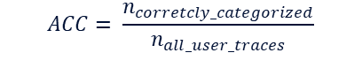
Communication and Utilization of Confidence Values
2.3 Evaluation Results
The evaluation dataset is the same as shown before, with 8 user groups present in the simulation.
Values are randomly corrupted in the dataset, according to a missing rate:
Classification accuracy (ACC) is measured after a hypothetical CF utilizes the imputed dataset:
$$missing_rate= \frac{n_{missing_observations}}{n_{all_observations}}$$
$$ACC= \frac{n_{corretcly_categorized}}{n_{all_user_traces}}$$
Inferred label
Data+mask
Imputer
Imp. data
Classifier
Inferred label
Data+mask
ICI
12
Notes:
After the imputation models reconstructed the missing information, we fed the imputed data to a hypothetical CF, in this case a classifier which was tasked with distinguishing between the user groups.
With this we were able to measure a classification accuracy, which is once again the number of correctly categorized user traces divided by the number of all user traces.

Slide 40
Communication and Utilization of Confidence Values
2.3 Evaluation Results
 |  | Publication | ML | DL | Intgr.
kNN | K-nearest-neighbors | -
mean | Mean imputation | -
MICE | Multivariate Imputation By Chained Equations | [Buuren et al., 2011] | ✔
Miss Forest | Nonparametric Missing Value Imputation using Random Forest | [Stekhoven et al., 2012] | ✔
MIDA | Multiple Imputation using Denoising Autoencoders | [Gondara et al., 2018] |  | ✔
GAIN | Generative Adversarial Imputation Nets | [Yoon et al., 2018] |  | ✔
WGAIN | Wasserstein Generative Adversarial Imputation Nets | - |  | ✔
13
Notes:
We have chosen a few standalone imputation methods to compete against our ICI algorithm.
2 simple, kNN and mean imputation, 2 machine-learning-based ones: MICE and Missforest, and 2 deep-learning-based imputation methods: MIDA and GAIN.
WGAIN is our own modification to GAIN to try to improve it, but since the improvement was not significant, the algorithm wasn’t published separately.

Slide 41
Communication and Utilization of Confidence Values
2.3 Evaluation Results
 |  | ML | DL | Intgr.
kNN | K-nearest-neighbors
mean | Mean imputation
MICE | Multivariate Imputation By Chained Equations | ✔
Miss Forest | Nonparametric Missing Value Imputation using Random Forest | ✔
MIDA | Multiple Imputation using Denoising Autoencoders |  | ✔
GAIN | Generative Adversarial Imputation Nets |  | ✔
WGAIN | Wasserstein Generative Adversarial Imputation Nets |  | ✔
13
Notes:
On the right side you can see how the accuracy of the classifier changes by increasing the missing rate in the data

Slide 42
Communication and Utilization of Confidence Values
2.3 Evaluation Results
 |  | ML | DL | Intgr.
kNN | K-nearest-neighbors
mean | Mean imputation
MICE | Multivariate Imputation By Chained Equations | ✔
Miss Forest | Nonparametric Missing Value Imputation using Random Forest | ✔
MIDA | Multiple Imputation using Denoising Autoencoders |  | ✔
GAIN | Generative Adversarial Imputation Nets |  | ✔
WGAIN | Wasserstein Generative Adversarial Imputation Nets |  | ✔
ICI | Integrated Classification with Imputation |  | ✔ | ✔
ICI
13
Notes:
And as you can see, our integrated imputation outperforms all standalone imputation methods on the whole missing rate range, so we can say that

Slide 43
Communication and Utilization of Confidence Values
2.3 Evaluation Results
 |  | ML | DL | Intgr.
kNN | K-nearest-neighbors
mean | Mean imputation
MICE | Multivariate Imputation By Chained Equations | ✔
Miss Forest | Nonparametric Missing Value Imputation using Random Forest | ✔
MIDA | Multiple Imputation using Denoising Autoencoders |  | ✔
GAIN | Generative Adversarial Imputation Nets |  | ✔
WGAIN | Wasserstein Generative Adversarial Imputation Nets |  | ✔
ICI | Integrated Classification with Imputation |  | ✔ | ✔
ICI
ICI is a high-performance integrated imputation with marginal additional cost.
13
Notes:
We have created a high-performance imputation method that works well on mobile network data, with only a marginal increase in computational cost.

Slide 44
Part 3:
Conclusion and Outlook on Machine Intuition
Covered in Chapter 14 of the dissertation
Notes:
Now, to conclude, I would like to recap my work for all 4 machine intuition topics:

Slide 45
Conclusion and Outlook on Machine Intuition
3.1 Recap of Work and Answers to Research Questions
Exemplification
New quantization alg. for facilitating communication between CFs.
Prediction
DL-based user movement prediction combined with a digital twin for radio environment prediction.
Associative Modeling
New deep clustering algorithm that outperforms SoTA on mobile network data.
Machine Confidence
New approach of integrating imputation into DL-based CFs.
Equal-Volume Quantization of Mobile Network Data using Bounding Spheres and Boxes
M. Kajó, B. Schultz, J. Ali-Tolppa, G. Carle
NOMS 2018 - 2018 IEEE/IFIP Network Operations and Management Symposium, 2018, pp. 1-9
Environment Modeling and Abstraction of Network States for Cognitive Functions
S. S. Mwanje, M. Kajó, S. Majumdar, G. Carle
NOMS 2020 - 2020 IEEE/IFIP Network Operations and Management Symposium, 2020, pp. 1-8
14
Notes:
For exemplification, we crated a new quantization algorithm to facilitate communication between cognitive functions.

Slide 46
Conclusion and Outlook on Machine Intuition
3.1 Recap of Work and Answers to Research Questions
Exemplification
New quantization alg. for facilitating communication between CFs.
Prediction
DL-based user movement prediction combined with a digital twin for radio environment prediction.
Associative Modeling
New deep clustering algorithm that outperforms SoTA on mobile network data.
Machine Confidence
New approach of integrating imputation into DL-based CFs.
Deep Clustering of Mobile Network Data with Sparse Autoencoders
M. Kajó, B. Schultz, G. Carle
NOMS 2020 - 2020 IEEE/IFIP Network Operations and Management Symposium, 2020, pp. 1-6
Clustering Mobile Network Data with Decorrelating Adversarial Nets
M. Kajó, J. Schnellbach, S. S. Mwanje and G. Carle
NOMS 2022-2022 IEEE/IFIP Network Operations and Management Symposium, 2022, pp. 1-9
14
Notes:
For associative modeling, as I have shown, we have created a new deep clustering algorithm that outperforms state-of-the-art on mobile network data.

Slide 47
Conclusion and Outlook on Machine Intuition
3.1 Recap of Work and Answers to Research Questions
Exemplification
New quantization alg. for facilitating communication between CFs.
Prediction
DL-based user movement prediction combined with a digital twin for radio environment prediction.
Associative Modeling
New deep clustering algorithm that outperforms SoTA on mobile network data.
Machine Confidence
New approach of integrating imputation into DL-based CFs.
Mobility and QoS Prediction for Dynamic Coverage Optimization
J. Ali-Tolppa, M. Kajó
NOMS 2020 - 2020 IEEE/IFIP Network Operations and Management Symposium, 2020, pp. 1-8
Machine-Learning-Based Predictive Handover
A. Masri, T. Veijalainen, H. Martikainen, S. S. Mwanje, J. Ali-Tolppa, M. Kajó
2021 IFIP/IEEE International Symposium on Integrated Network Management (IM), 2021, pp. 648-652
14
Notes:
For prediction, we combined a deep-learning-based user movement prediction with a digital twin to be able to predict radio conditions for users.

Slide 48
Conclusion and Outlook on Machine Intuition
3.1 Recap of Work and Answers to Research Questions
Exemplification
New quantization alg. for facilitating communication between CFs.
Prediction
DL-based user movement prediction combined with a digital twin for radio environment prediction.
Associative Modeling
New deep clustering algorithm that outperforms SoTA on mobile network data.
Machine Confidence
New approach of integrating imputation into DL-based CFs.
Robust Deep Learning against Corrupted Data in Cognitive Autonomous Networks
M. Kajó, J. Schnellbach, S. S. Mwanje and G. Carle
NOMS 2022-2022 IEEE/IFIP Network Operations and Management Symposium, 2022, pp. 1-7
14
Notes:
And finally, for machine confidence, we have proposed a new approach of integrating imputation capability into deep-learning-based cognitive functions.

Slide 49
Conclusion and Outlook on Machine Intuition
3.1 Recap of Work and Answers to Research Questions
Exemplification
New quantization alg. for facilitating communication between CFs.
Prediction
DL-based user movement prediction combined with a digital twin for radio environment prediction.
Associative Modeling
New deep clustering algorithm that outperforms SoTA on mobile network data.
Machine Confidence
New approach of integrating imputation into DL-based CFs.
A) Can mobile network automation benefit from machine intuition (feasible/practical/applicable)?
15
Notes:
Through these work, and through experience gathered with other unsupervised algorithms, I can safely answer to the first research question:

Slide 50
Conclusion and Outlook on Machine Intuition
3.1 Recap of Work and Answers to Research Questions
Exemplification
New quantization alg. for facilitating communication between CFs.
Prediction
DL-based user movement prediction combined with a digital twin for radio environment prediction.
Associative Modeling
New deep clustering algorithm that outperforms SoTA on mobile network data.
Machine Confidence
New approach of integrating imputation into DL-based CFs.
A) Can mobile network automation benefit from machine intuition (feasible/practical/applicable)? – Yes
15
Notes:
Yes, mobile network automation can benefit from machine intuition: it is feasible, it is often practical, and it is applicable to a wide range of use-cases.

Slide 51
Conclusion and Outlook on Machine Intuition
3.1 Recap of Work and Answers to Research Questions
Exemplification
New quantization alg. for facilitating communication between CFs.
Prediction
DL-based user movement prediction combined with a digital twin for radio environment prediction.
Associative Modeling
New deep clustering algorithm that outperforms SoTA on mobile network data.
Machine Confidence
New approach of integrating imputation into DL-based CFs.
B) Does machine intuition reduce/remove human labor?
16
Notes:
Unfortunately, whether it removes human labor is questionable.

Slide 52






Conclusion and Outlook on Machine Intuition
3.1 Recap of Work and Answers to Research Questions
Exemplification
New quantization alg. for facilitating communication between CFs.
Prediction
DL-based user movement prediction combined with a digital twin for radio environment prediction.
$$k$$
$$n_{latent}$$
$$Digital Twin$$
$$k$$
$$…$$
Associative Modeling
New deep clustering algorithm that outperforms SoTA on mobile network data.
Machine Confidence
New approach of integrating imputation into DL-based CFs.
$$c_{balance}$$
B) Does machine intuition reduce/remove human labor?
16
Notes:
All of the algorithms I have encountered have some kind of metaparmeter to which they are very sensitive, and requires tuning to the given task

Slide 53

Conclusion and Outlook on Machine Intuition
3.1 Recap of Work and Answers to Research Questions
Exemplification
New quantization alg. for facilitating communication between CFs.
Prediction
DL-based user movement prediction combined with a digital twin for radio environment prediction.
$$k$$
$$n_{latent}$$
$$Digital Twin$$
$$NN architecture$$
$$k$$
$$…$$
Associative Modeling
New deep clustering algorithm that outperforms SoTA on mobile network data.
Machine Confidence
New approach of integrating imputation into DL-based CFs.
$$c_{balance}$$
B) Does machine intuition reduce/remove human labor?
16
Notes:
As well as the burden of having to tailor the neural net architecture to the specific use-case

Slide 54

Conclusion and Outlook on Machine Intuition
3.1 Recap of Work and Answers to Research Questions
Exemplification
New quantization alg. for facilitating communication between CFs.
Prediction
DL-based user movement prediction combined with a digital twin for radio environment prediction.
$$k$$
$$n_{latent}$$
$$Digital Twin$$
$$Training supervision$$
$$NN architecture$$
$$k$$
$$…$$
Associative Modeling
New deep clustering algorithm that outperforms SoTA on mobile network data.
Machine Confidence
New approach of integrating imputation into DL-based CFs.
$$c_{balance}$$
B) Does machine intuition reduce/remove human labor?
16
Notes:
And also having to supervise the training process to make sure the algorithm converged

Slide 55
Conclusion and Outlook on Machine Intuition
3.1 Recap of Work and Answers to Research Questions
Exemplification
New quantization alg. for facilitating communication between CFs.
Prediction
DL-based user movement prediction combined with a digital twin for radio environment prediction.
$$k$$
$$n_{latent}$$
$$Digital Twin$$
$$Training supervision$$
$$NN architecture$$
$$k$$
$$…$$
Associative Modeling
New deep clustering algorithm that outperforms SoTA on mobile network data.
Machine Confidence
New approach of integrating imputation into DL-based CFs.
$$c_{balance}$$
B) Does machine intuition reduce/remove human labor? - No, it shifts supervision
16
Notes:
With all these aspects still requiring supervision, I would say the current unsupervised DL methods reduce, but don’t remove supervision, shifting it from labor intensive but simple labeling work to supervision that requires more expertise but is less heavy.

Slide 56
Conclusion and Outlook on Machine Intuition
3.2 Outlook
Creating
Evaluating
Analyzing
Unsupervised DL
Identify relationships
Applying
Use information in similar situations
Supervised DL
Understanding
Remembering
Bloom’s taxonomy of cognitive learning objectives
17
Notes:
So, to conclude, while it is true that unsupervised DL is more powerful cognitively than supervised DL…

Slide 57
Conclusion and Outlook on Machine Intuition
3.2 Outlook
Creating
Evaluating
Analyzing
Machine Intuition
Identify relationships
Applying
Use information in similar situations
Supervised DL
Understanding
Remembering
Bloom’s taxonomy of cognitive learning objectives
True Machine Intuition should eliminate human supervision, which requires further improvement in cognitive power.
17
Notes:
For true machine intuition, DL will have to climb the cognitive pyramid some more before we can completely eliminate human supervision.

Slide 59
Publications
Equal-Volume Quantization of Mobile Network Data using Bounding Spheres and Boxes
M. Kajó, B. Schultz, J. Ali-Tolppa, G. Carle
NOMS 2018 - 2018 IEEE/IFIP Network Operations and Management Symposium, 2018, pp. 1-9
Clustering Mobile Network Data with Decorrelating Adversarial Nets
M. Kajó, J. Schnellbach, S. S. Mwanje, G. Carle
NOMS 2022-2022 IEEE/IFIP Network Operations and Management Symposium, 2022, pp. 1-9
Environment Modeling and Abstraction of Network States for Cognitive Functions
S. S. Mwanje, M. Kajó, S. Majumdar, G. Carle
NOMS 2020 - 2020 IEEE/IFIP Network Operations and Management Symposium, 2020, pp. 1-8
Robust Deep Learning against Corrupted Data in Cognitive Autonomous Networks
M. Kajó, J. Schnellbach, S. S. Mwanje, G. Carle
NOMS 2022-2022 IEEE/IFIP Network Operations and Management Symposium, 2022, pp. 1-7
Deep Clustering of Mobile Network Data with Sparse Autoencoders
M. Kajó, B. Schultz, G. Carle
NOMS 2020 - 2020 IEEE/IFIP Network Operations and Management Symposium, 2020, pp. 1-6
Classic Artificial Intelligence: Tools for Autonomous Reasoning
S. S. Mwanje, M. Kajó, B. Schultz, K. Hatonen, I. Malanchini
Towards Cognitive Autonomous Networks: Network Management Automation for
5G and Beyond, 2020, pp. 173-201
Mobility and QoS Prediction for Dynamic Coverage Optimization
J. Ali-Tolppa, M. Kajó
NOMS 2020 - 2020 IEEE/IFIP Network Operations and Management Symposium, 2020, pp. 1-8
Modeling and Abstraction of Network and Environment States Using Deep Learning
S. S. Mwanje, M. Kajó, J. Ali-Tolppa
IEEE Network, 2020, vol. 34, no. 6, pp. 8-13
Machine Learning: Tools for End-to-End Cognition
S. S. Mwanje, M. Kajó, B. Schultz
Towards Cognitive Autonomous Networks: Network Management Automation for
5G and Beyond, 2020, pp. 203-254
Neural-Network-based Quantization for Network Automation
M. Kajó, S. S. Mwanje, B. Schultz, G. Carle
arXiv preprint arXiv:2103.04764, 2021
Cognitive Autonomy for Network Self-Healing
J. Ali-Tolppa, M. Kajó, B. Gajic, I. Malanchini, S. S. Mwanje, B. Schultz, Q. Liao
Towards Cognitive Autonomous Networks: Network Management Automation for
5G and Beyond, 2020, pp. 345-384
Machine-Learning-Based Predictive Handover
A. Masri, T. Veijalainen, H. Martikainen, S. S. Mwanje, J. Ali-Tolppa, M. Kajó
2021 IFIP/IEEE International Symposium on Integrated Network Management (IM), 2021, pp. 648-652
Notes:
For true machine intuition, DL will have to climb the cognitive pyramid some more before we can completely eliminate human supervision.

Slide 60
Backup Slides

Slide 61

Machine Intuition
Deep Learning
DL (Deep Learning) algorithms learn to model data through a hierarchy of rules.
Because of their layered architecture, neural nets are a natural choice for this.
Conv. + BN. + ReLU
FC + BN. + ReLU
Feature vis.
Max-pool.
Softmax

Slide 62
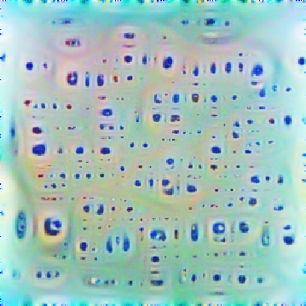



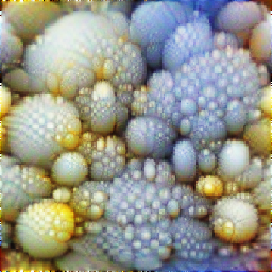





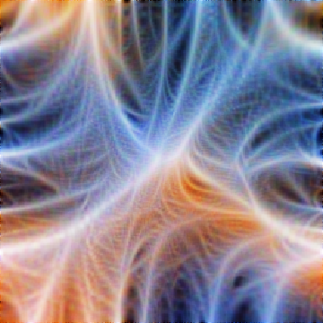
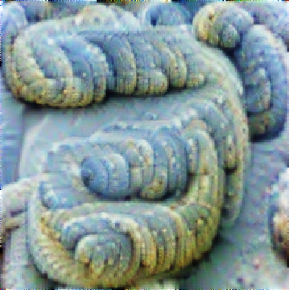
Machine Intuition
Deep Learning
Abstraction increases
DL (Deep Learning) algorithms learn to model data through a hierarchy of rules.
Because of their layered architecture, neural nets are a natural choice for this.
The hierarchical rules create increasingly abstract repre-sentations in the model.
Conv. + BN. + ReLU
FC + BN. + ReLU
Feature vis.
Max-pool.
Softmax

Slide 63
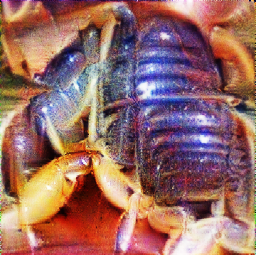
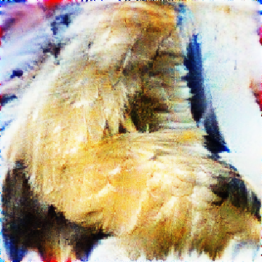
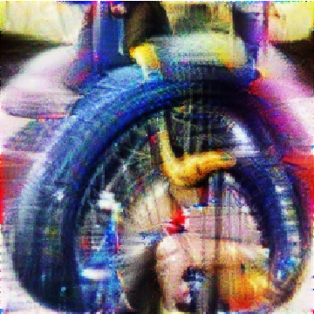
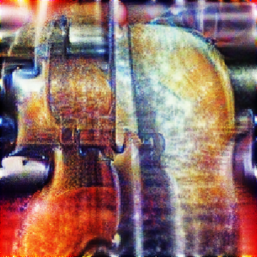
Machine Intuition
Deep Learning
Abstraction increases
“Scorpion”
“Stork”
DL (Deep Learning) algorithms learn to model data through a hierarchy of rules.
Because of their layered architecture, neural nets are a natural choice for this.
“Unicycle”
“Violin”
The hierarchical rules create increasingly abstract repre-sentations in the model.
Conv. + BN. + ReLU
FC + BN. + ReLU
Feature vis.
Max-pool.
Softmax
Subsequent abstractions can realize human-like logic.

Slide 64
Machine Intuition
Machine Learning Paradigms
Supervised learning
Substantial human/computational effort in data preparation:
Manual labeling of anomalies
Surveys
Drive tests
Ray-traced coverage maps

Slide 65
Machine Intuition
Machine Learning Paradigms
Supervised learning
Substantial human/computational effort in data preparation:
Manual labeling of anomalies
Surveys
Drive tests
Ray-traced coverage maps
Unsupervised learning
Easy-to-automate data prepa-ration:
Removal of invalid values
KPI calculation
Aggregation in time/space
Data segmentation

Slide 66
Machine Intuition
Machine Learning Paradigms
Supervised learning
Substantial human/computational effort in data preparation:
Manual labeling of anomalies
Surveys
Drive tests
Ray-traced coverage maps
Unsupervised learning
Easy-to-automate data prepa-ration:
Removal of invalid values
KPI calculation
Aggregation in time/space
Data segmentation
Reinforcement learning
Experimentation cannot be done directly on real mobile networks*:
High cost of failure
Long time to convergence

Slide 67
Machine Intuition
Machine Learning Paradigms
Supervised learning
Substantial human/computational effort in data preparation:
Manual labeling of anomalies
Surveys
Drive tests
Ray-traced coverage maps
Unsupervised learning
Easy-to-automate data prepa-ration:
Removal of invalid values
KPI calculation
Aggregation in time/space
Data segmentation
Reinforcement learning
Experimentation cannot be done directly on real mobile networks*:
High cost of failure
Long time to convergence
Unsupervised learning only requires light data preparation.

Slide 68






Deep Clustering of Mobile Network Data
Example Use Case in Network Automation
Quality of Experience (QoE) estimation tries to quantify user satisfaction:
-
Map measured Key Performance Indicators (KPIs) to QoE values.
Good QoE
Direct KPIs: THP, Latency, …
Bad QoE

Slide 69
Deep Clustering of Mobile Network Data
Example Use Case in Network Automation
Quality of Experience (QoE) estimation tries to quantify user satisfaction:
-
Map measured Key Performance Indicators (KPIs) to QoE values.
Problem
Context greatly influences the QoE:
Different situations
Different expectations
Good QoE
Direct KPIs: THP, Latency, …
Bad QoE

Slide 70
Deep Clustering of Mobile Network Data
Example Use Case in Network Automation
Quality of Experience (QoE) estimation tries to quantify user satisfaction:
Cluster the user contexts into usage types.
Map measured Key Performance Indicators (KPIs) to QoE values for each usage type.
Solution
User-context-specific QoE maps.
Clustering
Type 1: stationary browsing
Indirect KPIs: Traffic pattern, movement, …
Type 2: slow-moving VoIP
Good QoE
Type 3: fast-moving VoIP
+
Direct KPIs: THP, Latency, …
Bad QoE

Slide 71


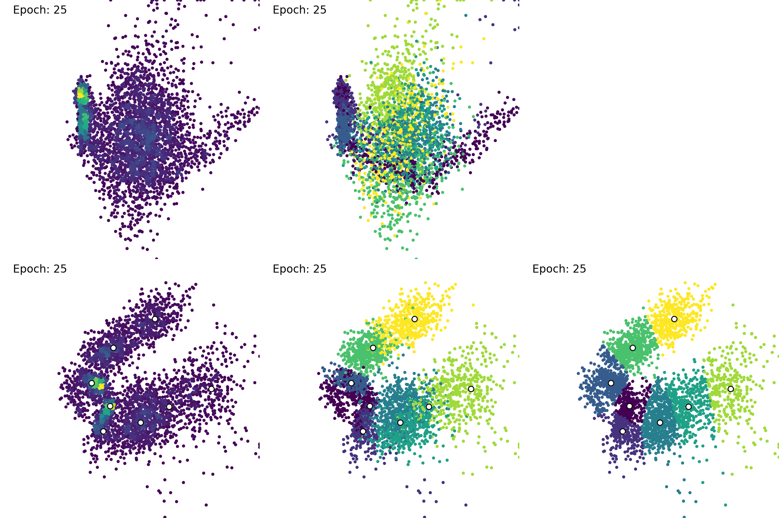



Deep Clustering of Mobile Network Data
DANCE Training
$$p_{g}$$
Sparse
Dense
Label₀
Label₇
$$Z_{recon.}$$
Purely Reconstructive Features
$$Z_{clust.}$$
k-Means
Clustering Relevant Features

Slide 72
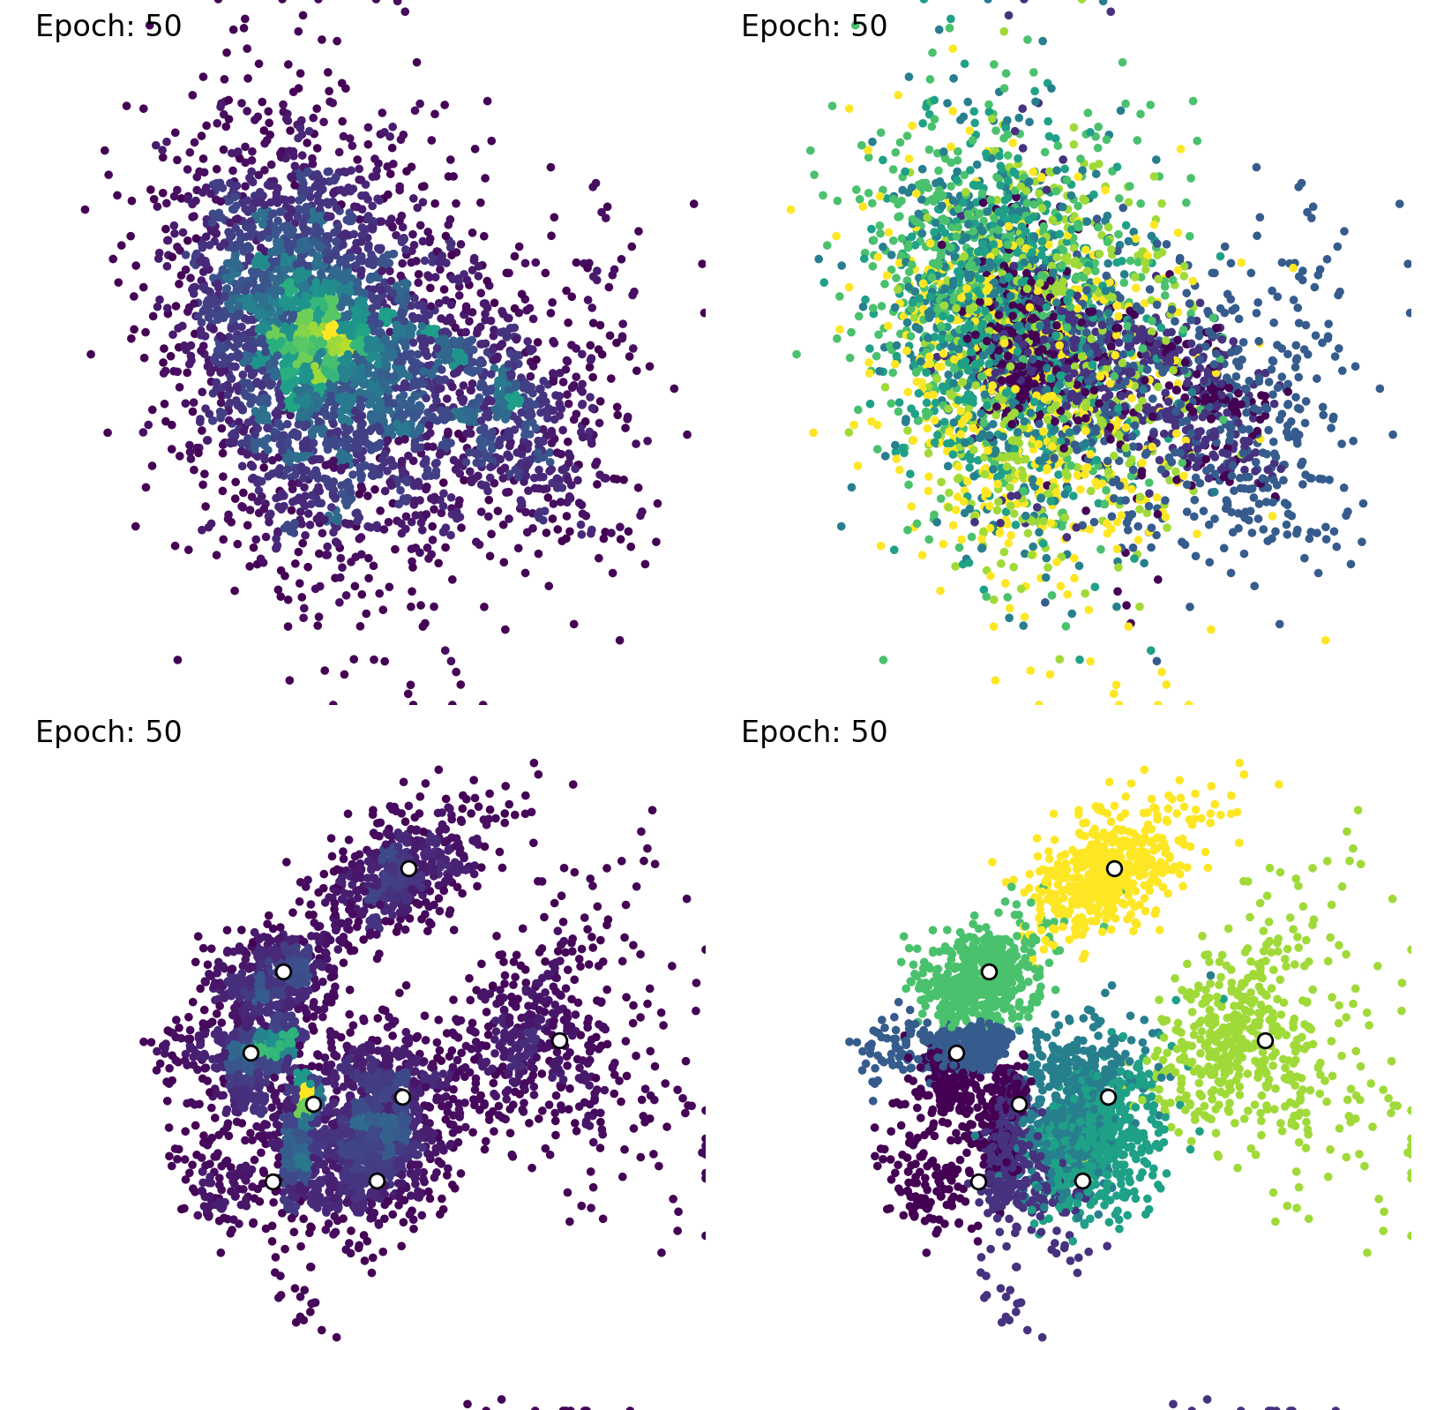
Deep Clustering of Mobile Network Data
DANCE Training
$$p_{g}$$
Sparse
Dense
Label₀
Label₇
$$Z_{recon.}$$
Purely Reconstructive Features
$$Z_{clust.}$$
k-Means
Clustering Relevant Features

Slide 73
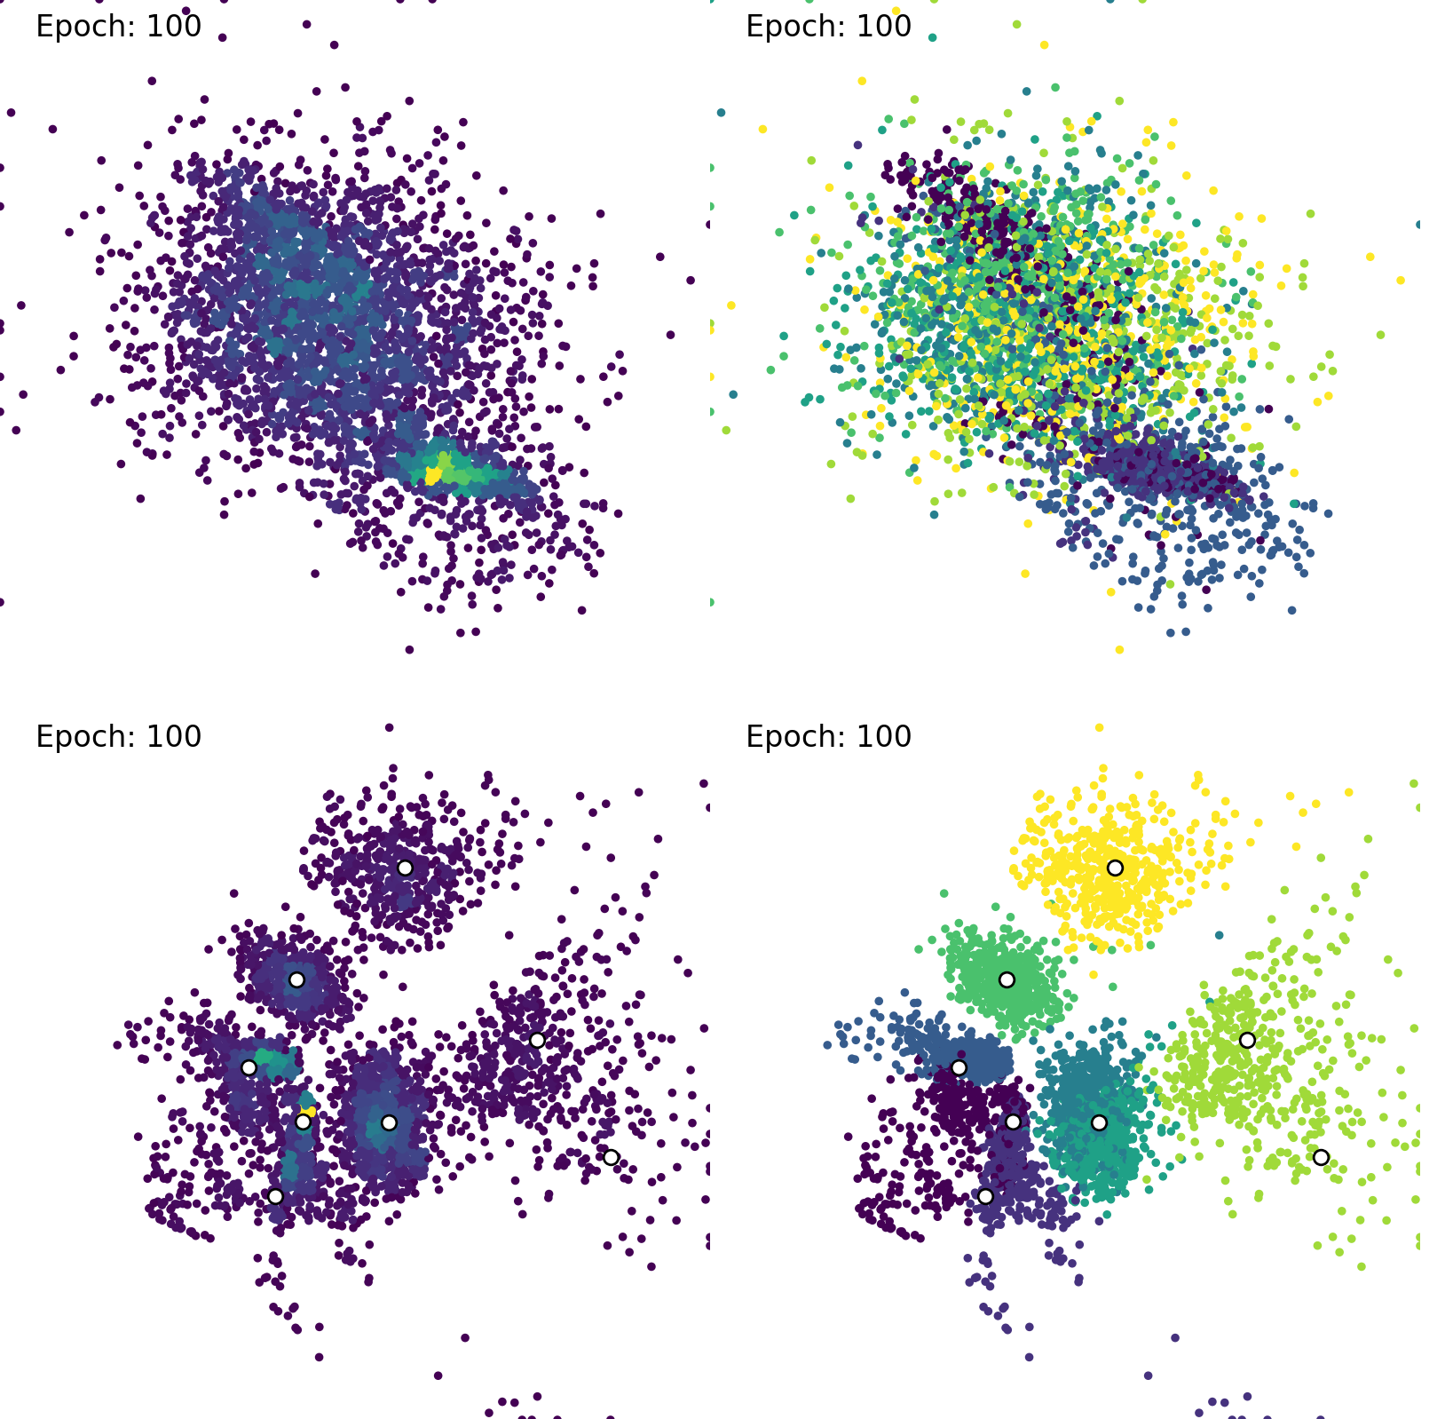
Deep Clustering of Mobile Network Data
DANCE Training
$$p_{g}$$
Sparse
Dense
Label₀
Label₇
$$Z_{recon.}$$
Purely Reconstructive Features
$$Z_{clust.}$$
k-Means
Clustering Relevant Features

Slide 74
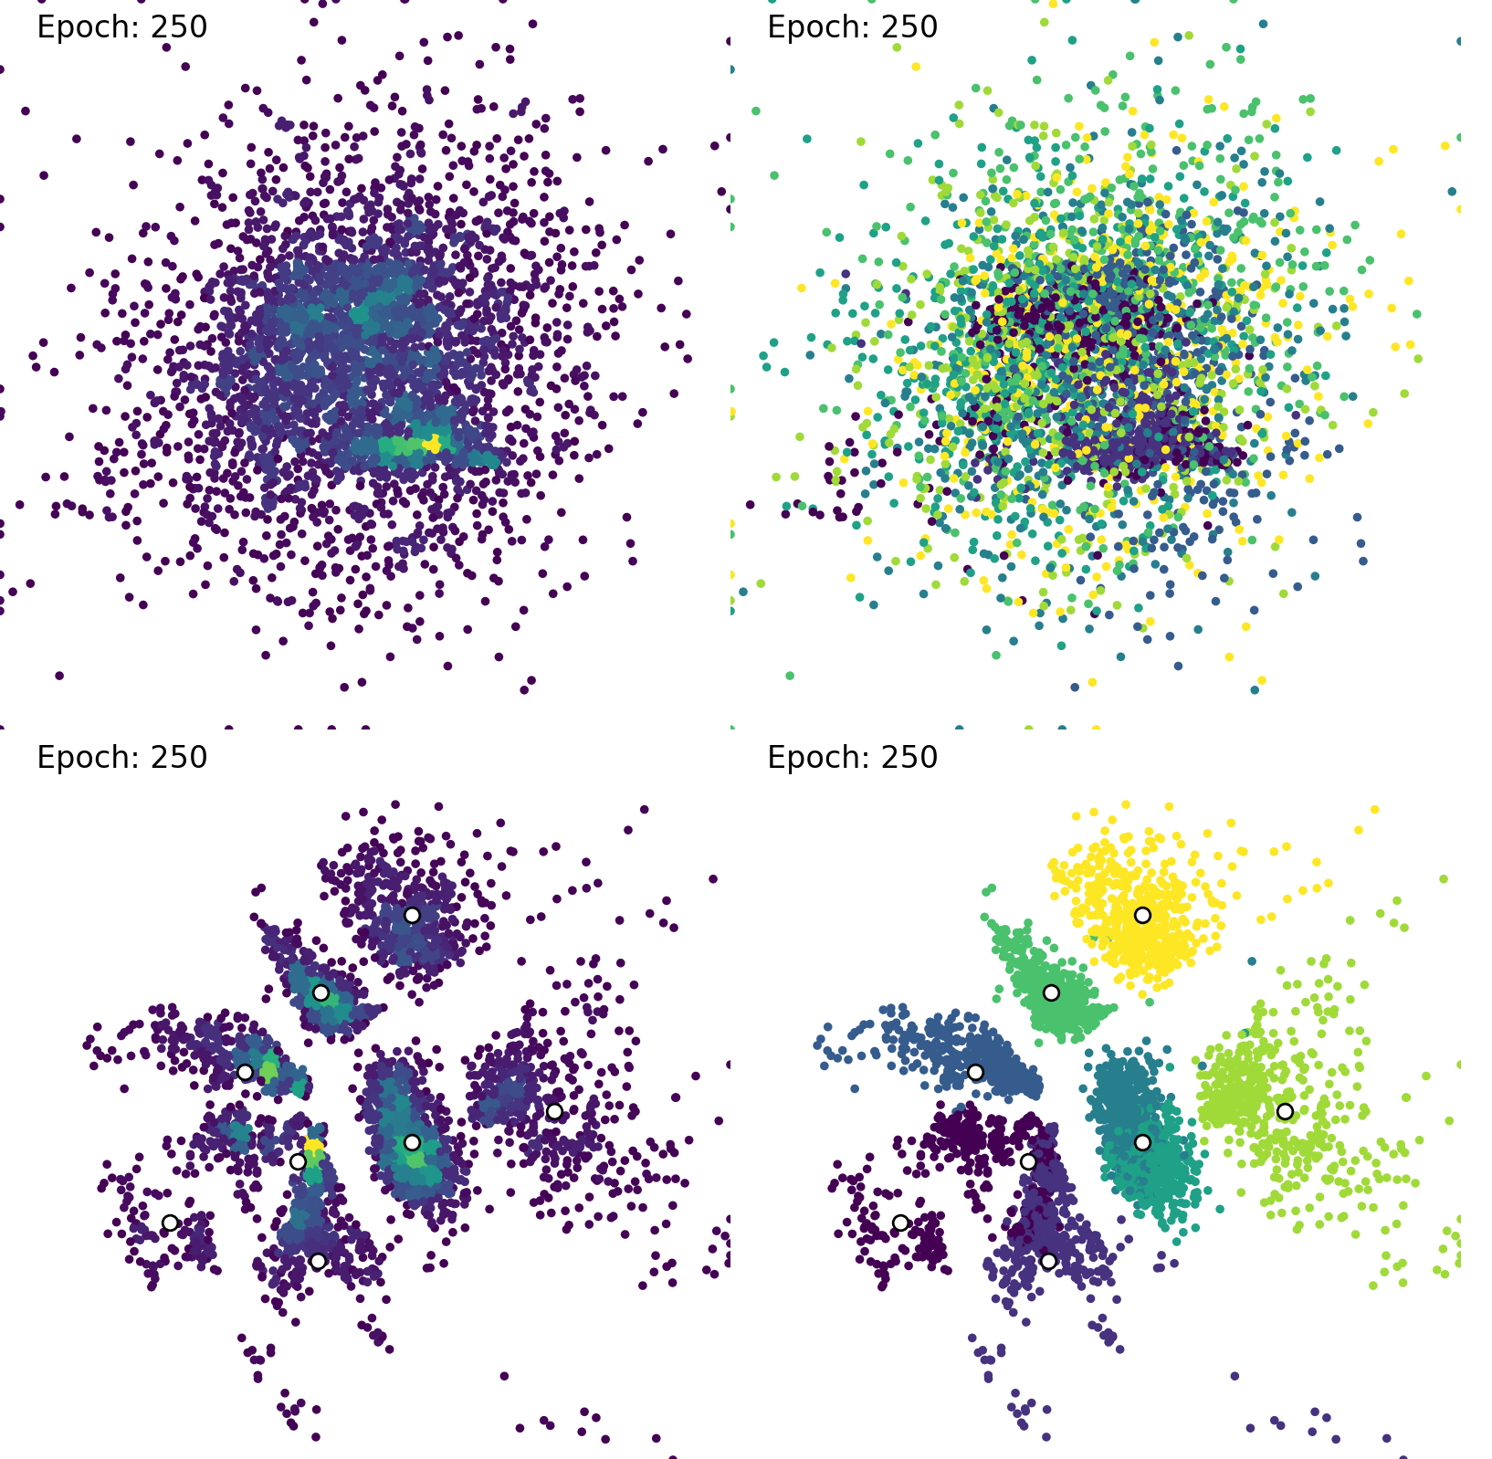
Deep Clustering of Mobile Network Data
DANCE Training
$$p_{g}$$
Sparse
Dense
Label₀
Label₇
$$Z_{recon.}$$
Purely Reconstructive Features
$$Z_{clust.}$$
k-Means
Clustering Relevant Features

Slide 75
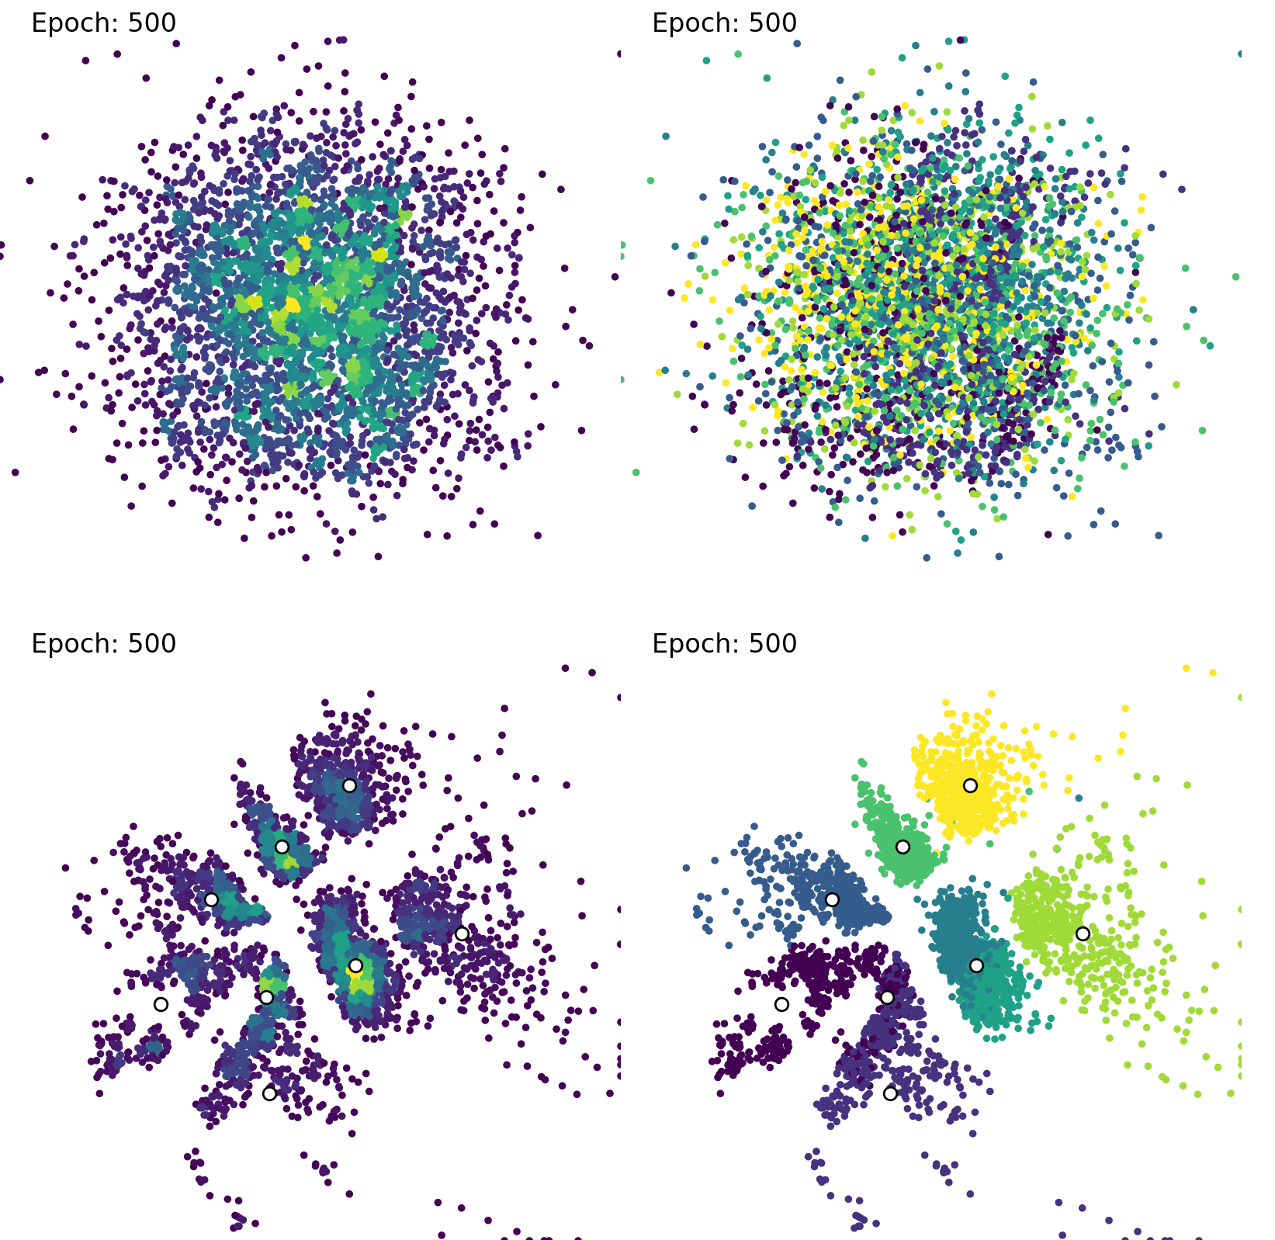
Deep Clustering of Mobile Network Data
DANCE Training
$$p_{g}$$
Sparse
Dense
Label₀
Label₇
$$Z_{recon.}$$
Purely Reconstructive Features
$$Z_{clust.}$$
k-Means
Clustering Relevant Features

Slide 76
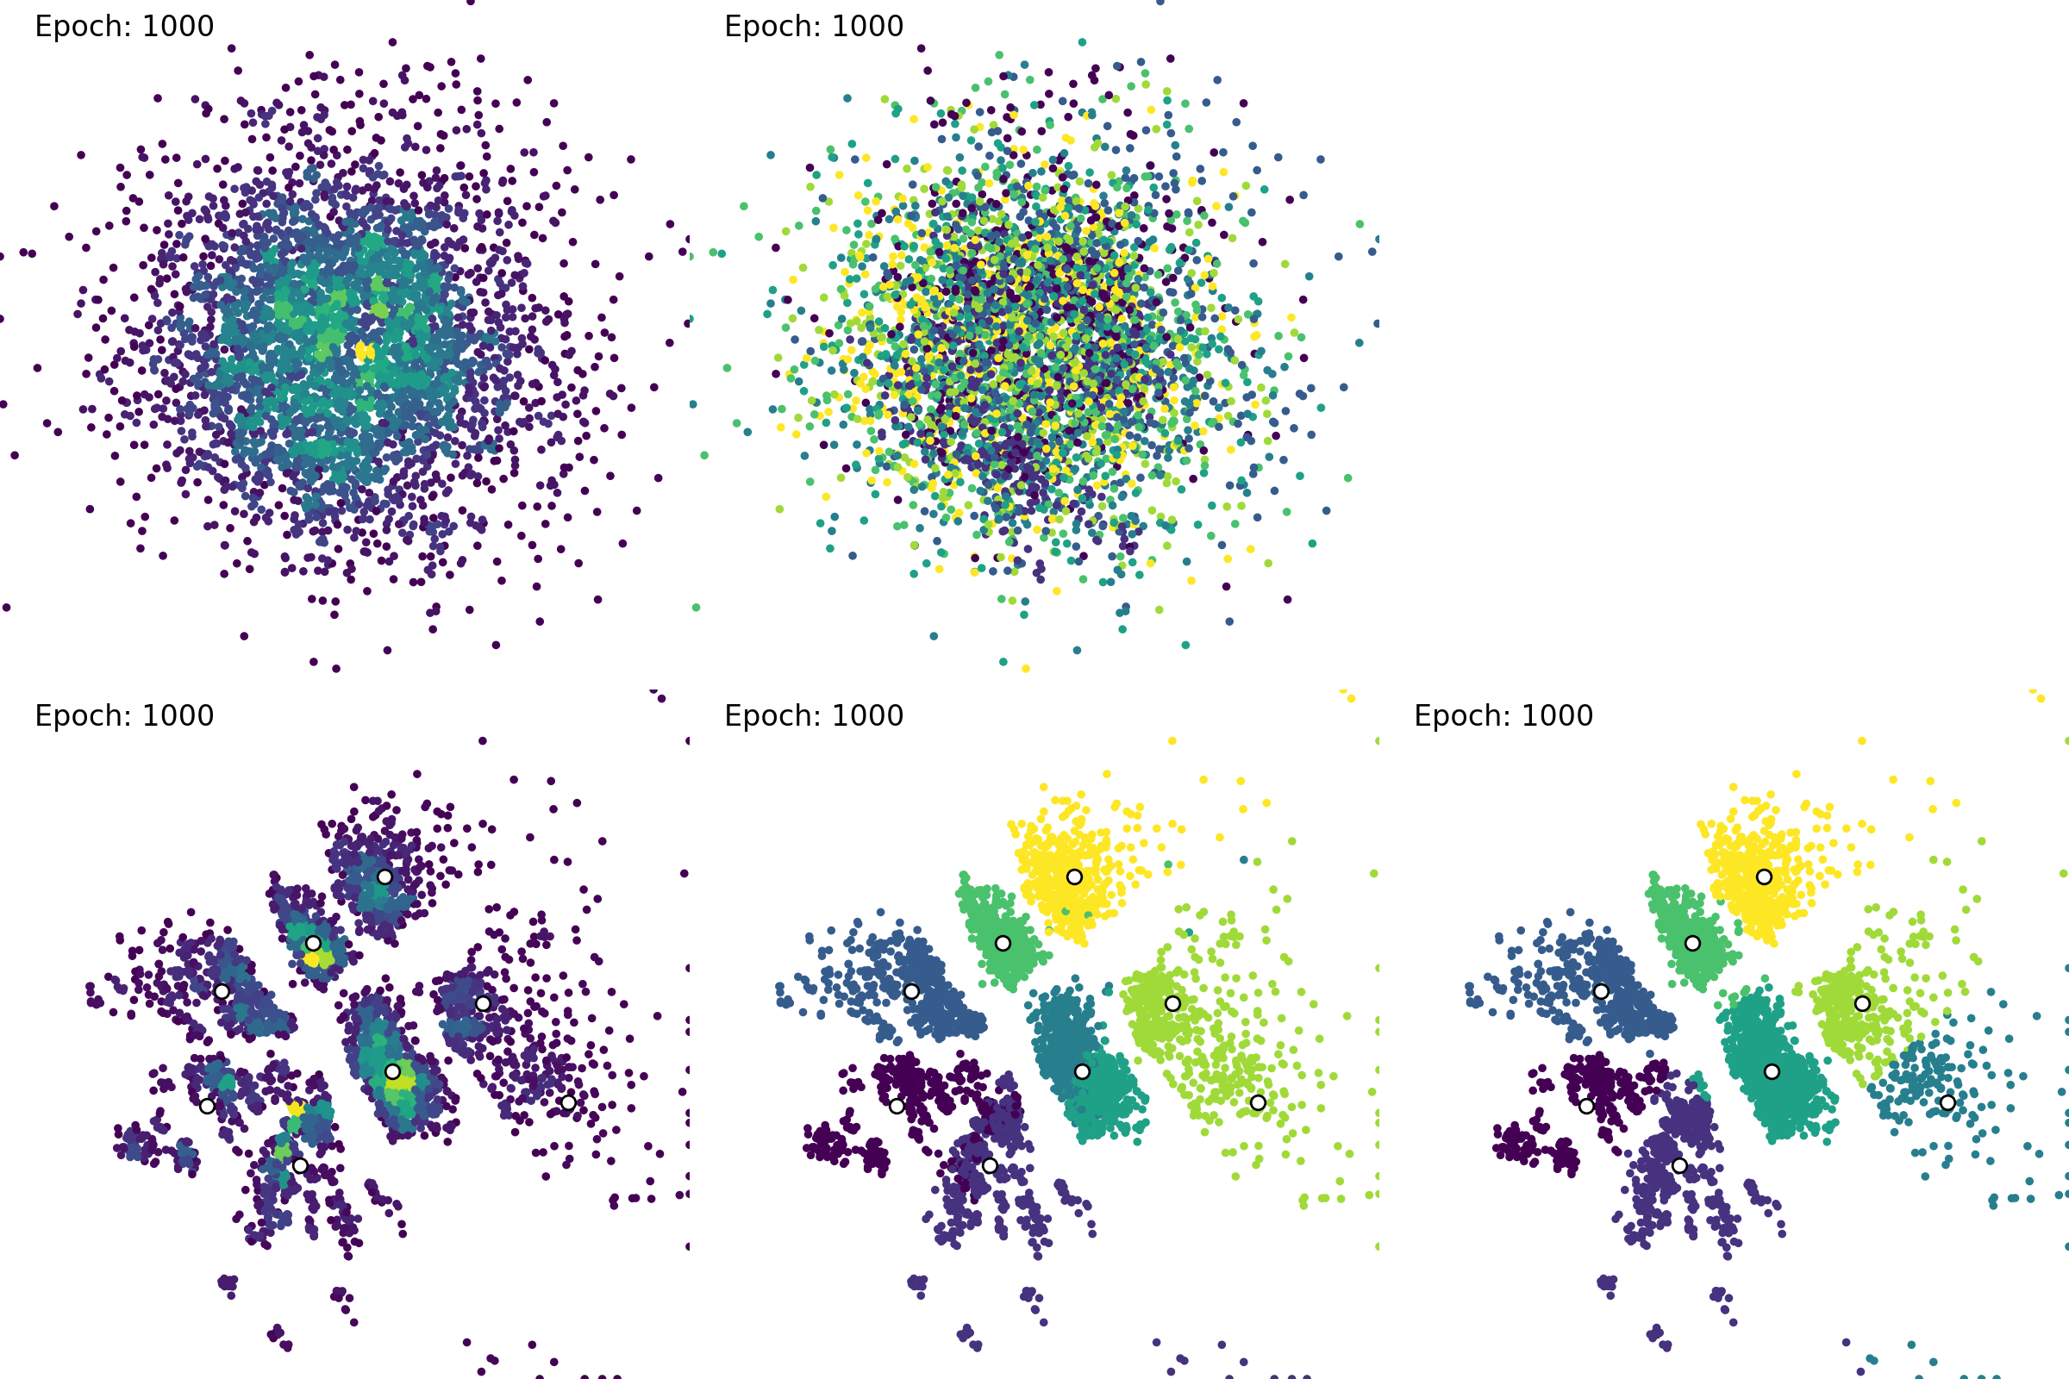
Deep Clustering of Mobile Network Data
DANCE Training
$$p_{g}$$
Sparse
Dense
Label₀
Label₇
$$Z_{recon.}$$
Purely Reconstructive Features
$$Z_{clust.}$$
k-Means
Clustering Relevant Features

Slide 77

Deep Clustering of Mobile Network Data
DANCE Training
$$p_{g}$$
Sparse
Dense
Label₀
Label₇
$$Z_{recon.}$$
Purely Reconstructive Features
$$Z_{clust.}$$
k-Means
Clusters
Unfortunately, even with the clustering-relevant features separated, k-means is unreliable in finding the clusters.
Clustering Relevant Features

Slide 78
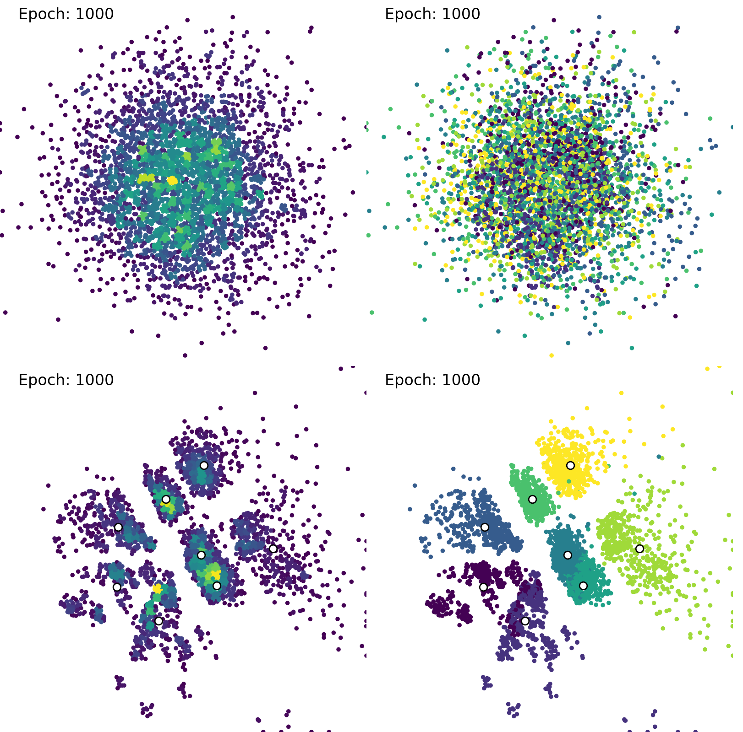

Deep Clustering of Mobile Network Data
RIM Initialization in DANCE
$$p_{g}$$
Sparse
Dense
Label₀
Label₇
$$Z_{recon.}$$
Purely Reconstructive Features
$$Z_{clust.}$$
RIM
Initial Clusters
Clustering Relevant Features
The Regularized Information Maximization (RIM) algorithm is capable of reliably finding an initial set of cluster centroids, by looking for sparse separating areas between dense groups of points.

Slide 79
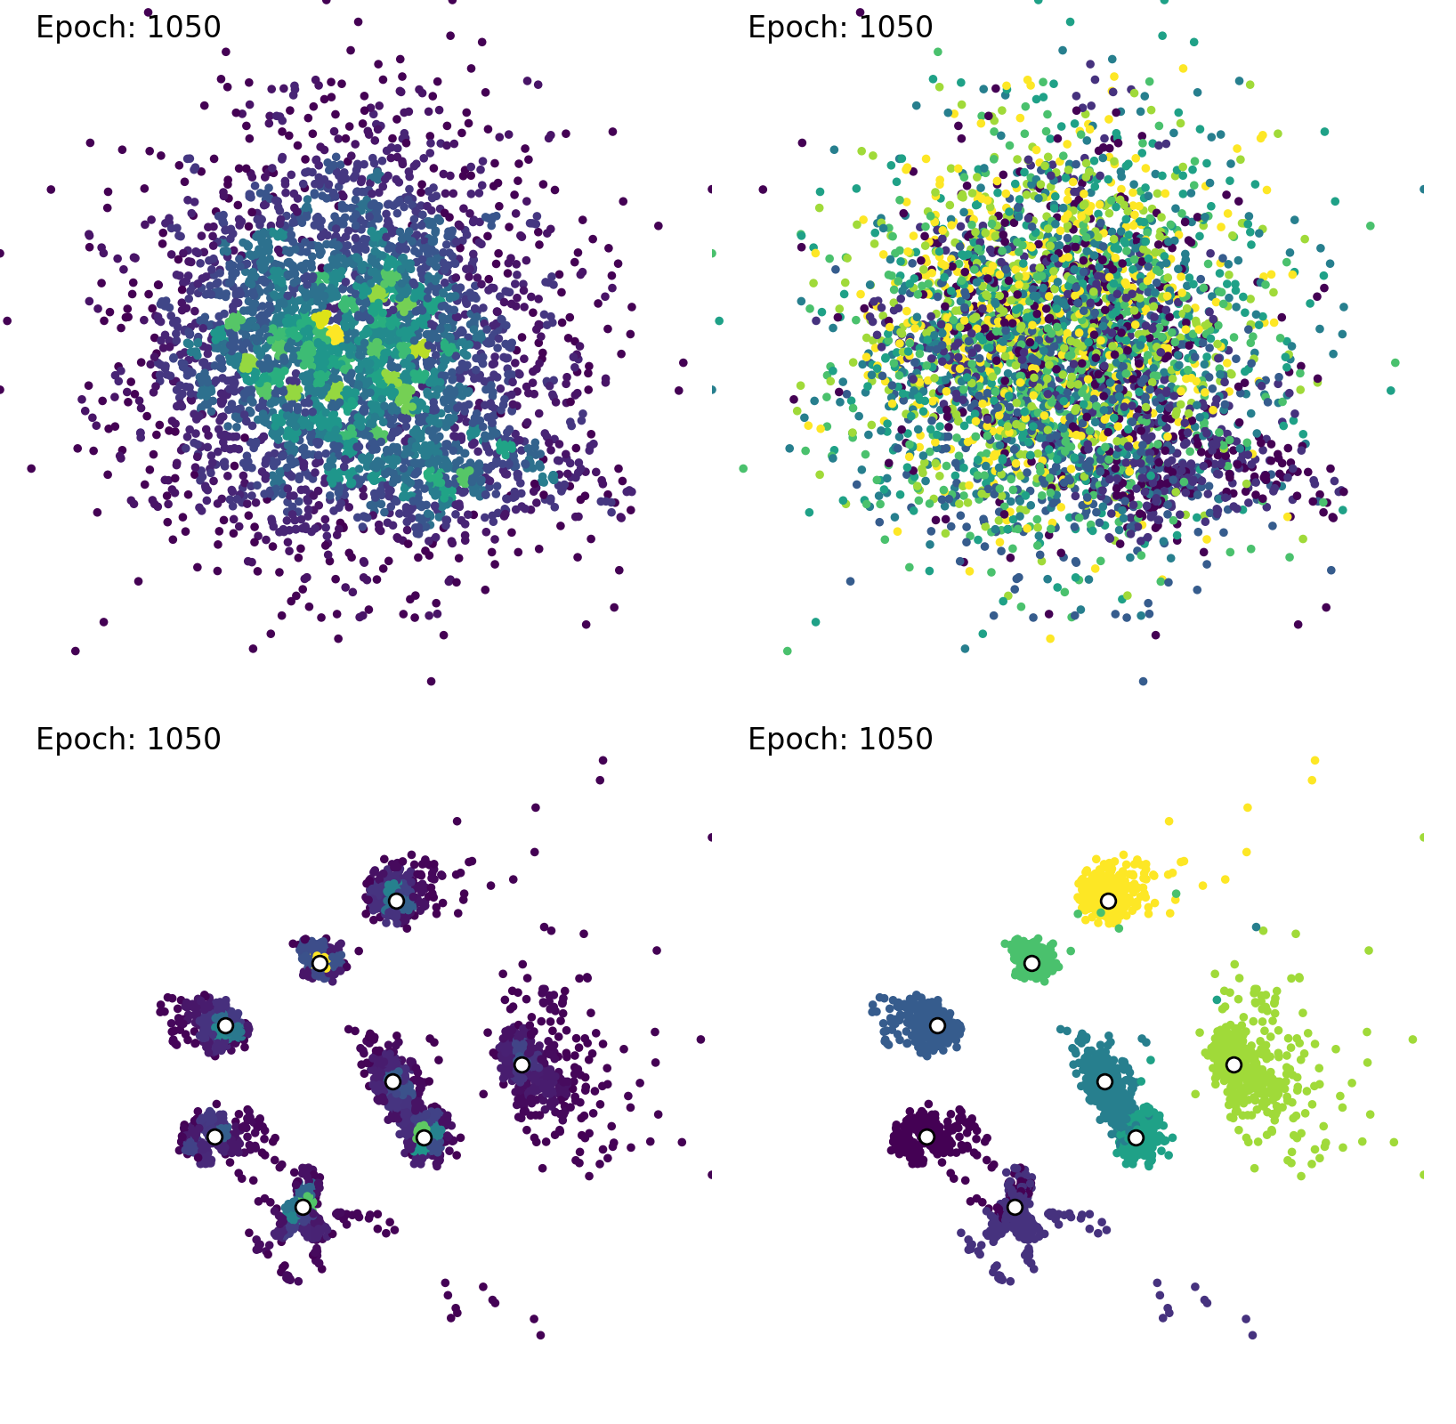
Deep Clustering of Mobile Network Data
DEC Refinement in DANCE
$$p_{g}$$
Sparse
Dense
Label₀
Label₇
$$Z_{recon.}$$
Purely Reconstructive Features
$$Z_{clust.}$$
RIM
DEC
Clusters
Clustering Relevant Features
Using the initial clusters provided by RIM, the Deep Embedded Clustering (DEC) algorithm can refine and finalize the clustering, by grouping the clusters more tightly together.

Slide 80
Associative Modeling
Evaluation Data
Collected simulated mobile network data containing 8 user groups:
Throughput measured on the application level
Radio quality indicators: RSRP, allocated PRBs, SINR, …
Radio Resource Control (RRC) status flags (connected, Radio Link Failure (RLF), handover signaling, idle etc.)
Omni micro
3-sector macro

Slide 81
Associative Modeling
Evaluation Results
Encoder
Decoder
 | ACC avg. (± std.)
DEC (Deep Embedded Clustering) | 0.7409 (±0.021)
ACAI (Adversarially Constrained Autoencoder Interpolation) | 0.7629 (±0.040)
IMSAT (Information Maximizing Self- Augmented Training) | 0.4775 (±0.072)
DCCS (Deep image Clustering with Category-Style representation) | 0.8416 (±0.055)
DANCE | 0.8923 (±0.041)
DEC
Clusters
Encoder
Decoder
Discrim.
k-Means
Clusters
Encoder
Clusters
Constraints
DANCE | 0.8923 (±0.041)
Encoder
Discrim.
Discrim.
Constraints
Clusters

Slide 82
Machine Confidence
Evaluation Results
Non-deep-imputation:
K-nearest-neighbors
Mean imputation
MICE
MissForest
MIDA (Multiple Imputation using Denoising Autoencoders)
Encoder
Decoder
Classif.
Classes
(W)GAIN ((Wasserstein) Generative Adversarial Imputation Nets)
Encoder
Decoder
ICI
Classif.
Classes
Discrim.

Slide 83
Robust Deep Learning against Corrupted Data in CANs
Conclusion
With integrated imputation:
CFs can potentially withstand a significant amount of corrupted data.
The processing of missing or corrupted inputs requires no additional processing step.
CF₁
CF₂

Slide 84
Robust Deep Learning against Corrupted Data in CANs
Conclusion
With integrated imputation:
CFs can potentially withstand a significant amount of corrupted data.
The processing of missing or corrupted inputs requires no additional processing step.
Continuation of the concept:
Continuous confidence values in [0, 1].
Generating confidence values in CFs.
CF₁
CF₂
Confidence mask generation

